Slide 1
Improving Mood Course
Session 2

Slide 2
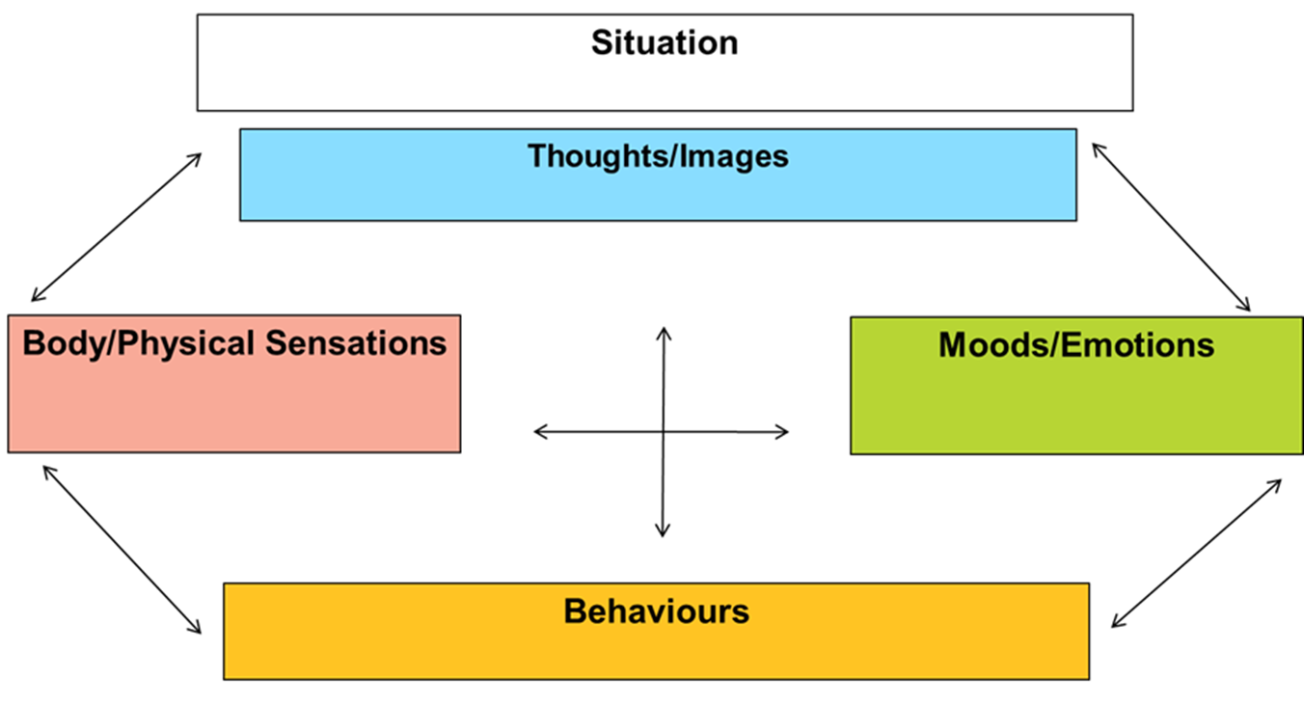
Review of Last Week…
CBT and the 5 areas model
Problem statement and goal setting
Introduction to Depression

Slide 3
Home Practice Review: Breakout Rooms
How did you find the first session?
How was your weekly task setting SMART goals?
Did you manage to fill in the 5 Areas (CBT) Model?
Any comments/ questions?
Notes:
2 breakout rooms for group discussion
Exercise analogy for homework – reinforce this in breakout rooms

Slide 4
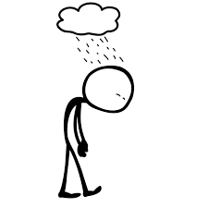
This Week….
Understanding the vicious cycle of depression
Introducing Behaviorual Activation

Slide 5
Vicious Cycle of Depression
Depression leads to doing less but doing less makes us feel worse
The less we do, the less we then feel like doing and the less positive experiences we engage in
This creates a cycle of low mood and avoidance which gets worse over time
Notes:
Depression leads to doing less but doing less makes us feel worse
One of the most common ways people respond to feeling low or depressed is that they stop doing enjoyable activities and carrying out the simple everyday tasks they once did. Stopping activities and becoming more sedentary is one of the things that keeps the vicious and distressing cycle of depression going. Stopping or reducing pleasurable activities decreases the opportunities you have to improve your mood.
The less we do the less we feel like doing – creates a cycle of avoidance and low mood – gets worse overtime

Slide 6
Vicious Cycle of Depression
Depressed
Mood
LONG TERM - Increased guilt,
hopelessness,
ineffectiveness
Low energy, fatigue,
decreased interest,
Negative thinking
SHORT TERM – Symptom Relief
Decreased activity,
neglect of
responsibilities

Slide 7
Case Study: Patrick
Patrick was 40 years old when he was first diagnosed with depression. Previously, he’d led a happy, productive life. He was married and enjoyed his work as an engineer; he enjoyed cycling and walking at weekends. His problems started when he was made redundant.
Although the company had been having financial problems for some time, he was very surprised when he realised his position was being axed and began to worry that his performance had been below standard or that his supervisors and colleagues hadn’t liked him.
In the months that followed, he applied and was interviewed for several other jobs, but wasn’t offered any of them. He began to think that he was inadequate and worthless, and, as more and more time passed without finding work, he began to feel hopeless. His feelings turned to despair when his wife was promoted in her job—instead of feeling pleased for her, he was just more convinced that he was useless. He avoided having conversations with his wife because he felt embarrassed by his unemployment. He stopped exercising and socialising, and felt tired and listless most of the time. He stopped shaving and brushing his hair, and then avoided going out at all because he thought he looked shabby. He eventually stopped applying for jobs because he thought it was ‘pointless’ - he believed that no one would want to hire him.

Slide 8
What advice would you give to Patrick and why?
Notes:
5 minutes as a group or in break out rooms
Explore what the group might suggest to Patrick
Prompts:
Be more active
Eat better
Spend less time on TV/ phone/ sleeping
Connect with people around him

Slide 9
Behavioural Activation
Helps change unhelpful behaviours to break the cycle of depression
Recommended by NICE as the first line of psychological treatment
Focuses on the link between what we do and how we feel

Slide 10
Reversing the Cycle
Increased Activity
Fair and Realistic
Thinking
Do different to feel different
Increasing activity is one of the simplest ways to combat the vicious cycle of depression
Greater energy &
motivation
Short term:
May feel a little more tired
Improved Depression
Long Term:
Feeling hopeful, more
confident, less guilty

Slide 11
Benefits of increased activity
Motivating us to do more
Being with others
Stimulating the body to produce natural anti-depressants
Using up the adrenaline created by anger and anxiety
Building self-esteem
Giving an alternative focus
Giving us a sense of achievement & enjoyment
Making us feel less tired

Slide 12
Break

Slide 13
Behavioural Activation: The Steps

Slide 14
Step 1: Baseline Diary
Keep a Baseline Diary
Record your current daily activities on your weekly record sheet
Record your mood throughout the day
Notes:
Baseline needed to identify where changes could be made
Important not to skip this step
Record mood to look for patterns between what you do and how you feel

Slide 15
Patrick’s Baseline Diary

Slide 16
Now your turn….
What did you think of Patrick’s baseline diary?
Did you notice anything?
What are your thoughts of Patrick’s activity and emotions? Can you see any links?
What changes might Patrick benefit from making?
Notes:
Flick back to previous slide to allow patients to answer questions

Slide 17
Step 2: Identify Activities
Divide the activities that you have lost the motivation to do into 3 categories:
Routine Activities
Pleasurable Activities
Necessary Activities
Notes:
Activities can be broken up into three separate categories
To have a healthy balance of mood we should include these three main
types of activities as part of our weekly routine.
Ask patients to suggest what each might be and examples of each
Routine Activities
Activities that are done day to day to make our lives more comfortable. Such as; washing,
housework, preparing food and exercise.
Necessary Activities
Activities that are essential and the longer we leave them the worse the negative consequences.
Such as; paying bills, applying for jobs, booking medical appointments.
Pleasurable Activities
Activities that give a sense of achievement or connectedness to others and improve our quality
of life. Such as; seeing friends, hobbies, gardening, sports.

Slide 18
Patrick’s Activity List
Routine Activities
Get out of bed
Shave
Brush hair
Clean bathroom
Wash plates
Cooking a meal
Pleasurable Activities
Exercising – walking running
going to the gym
Going to the pub with Darren
Reading a newspaper
Watch a film
Talking to my wife
Necessary Activities
Check e-mails/ answer e-mails
Open post
Respond to post
Apply for work
Going shopping

Slide 19
Step 3: Create a Hierarchy
Most Difficult
Medium Difficulty
Least Difficult
Notes:
These levels will be individual to you e.g. what is difficult for one person may be less difficult for another

Slide 20
Why might we rate activities from least to most difficult?
Notes:
It is important to work out which activities are going to be easier for you to carry out first, then you can slowly working towards those activities you may find more difficult.
Helps build confidence and motivation
If we start with hard activities and don’t achieve them, this can make us feel lower, what’s the point, reduce confidence etc.

Slide 21
Relaxation
Guided Imagery
https://www.youtube.com/watch?v=EAmkN-hL_dM

Slide 22
Home Practice
Keep Baseline Diary
Make list of activities
Rank into hierarchy

Slide 23
Home Practice Link
https://www.healthyminds.whct.nhs.uk/herefordshire-healthy-minds---patient-portal

Slide 24
Takeaway
One thing I would like to remember from this session…..​
Please write this in your booklet​
Put in the chat too if you would like to share with the group

Slide 25
Next week…
Continue steps of behavioural activation
Explore barriers and overcoming these

Slide 26
Thank you for attending! We look forward to seeing you all again at the session next week! If you have not filled in your questionnaires, please do this before you leave the session today.

